Slide 1
Introduction
Name: Troy Nsofor
Program: Computer Science Info & Technology
My AI specialization/interests are robotics, computers, etc.
Link: https://github.com/troynsofor-svg/Troy-Nsofor-AI-Portfolio

Slide 2
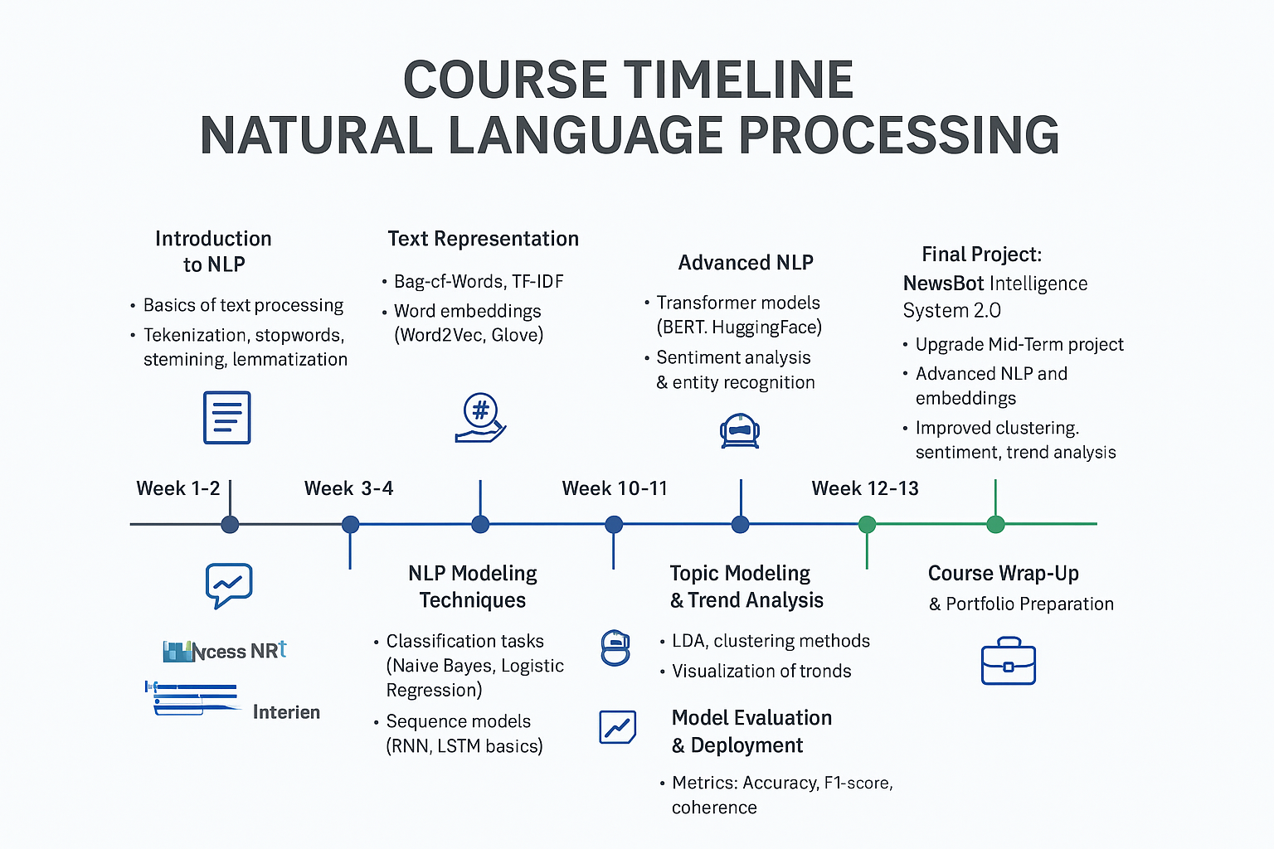
Learning Journey
Technologies/frameworks mastered: deep learning, natural language processing, computer vision, etc.
Growth Trajectory: I developed strong skills in coding cells, debugging issues, and applying NLP concepts to build practical, working AI features.

Slide 3
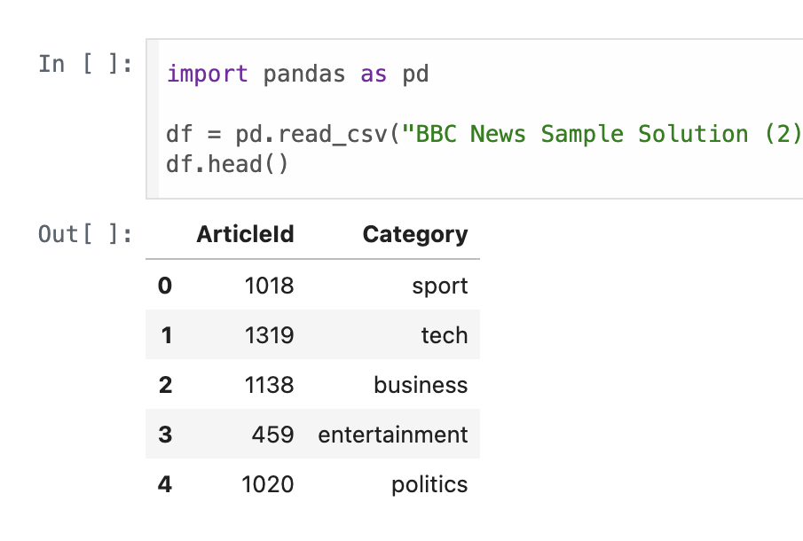
Featured Projects
NewsBot Intelligence System (Mid-Term)
NLP system clusters and summarizes news articles to deliver clear, structured insights.
Technologies: Jupyter Notebook / Google Colab, langdetect, pandas, etc.
Link: https://github.com/troynsofor-svg/ITAI2373-Portfolio

Slide 4
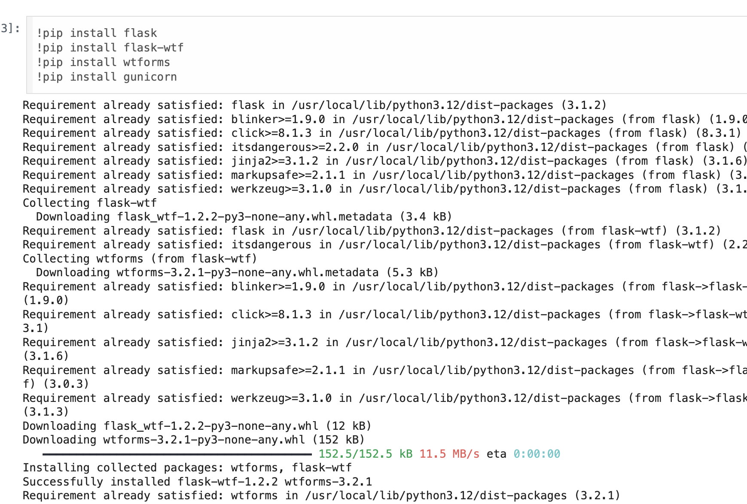
Featured Projects 2
NewsBot Intelligence System 2.0 (Final Project) -Enhanced platform with improved extraction, smarter summarization, and an interactive chatbot using advanced NLP models.
Technologies: Genism, Transformers, KMeans, Python, etc.
Link: https://github.com/troynsofor-svg/ITAI2373-NewsBot-Final

Slide 5
Skills & Competencies
Technical skills: NLP, ML, Python, model training
Core competencies: Working with real-world datasets, NLP preprocessing, Text classification and sentiment analysis, etc.
Soft skills: Communication, Teamwork, Collaboration, continuous learning.

Slide 6

Reflection & Next Steps
Reflection: I learned how to codes cells in Google Colab.
Next Steps: Explore deep and machine learning models and deploy full AI apps.
Contact information: troynsofor@gmail.com

